Slide 1
Introduction to Machine Learning FAI-Unit-II

Slide 2
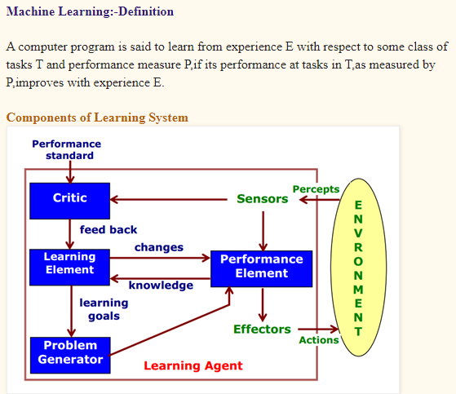
Learning
“Learning denotes changes in a system that enables system to do the same task more efficiently next time.”

Slide 3
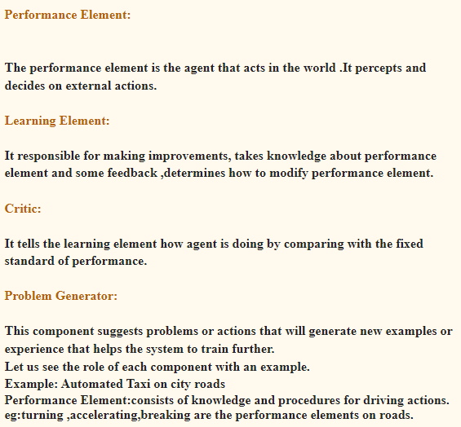
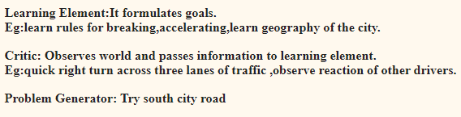

Slide 4
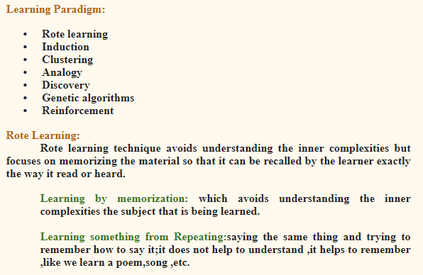

Slide 5
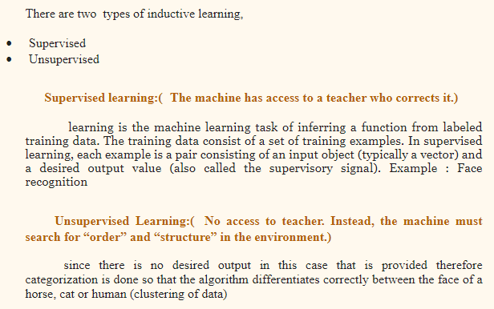
Inductive Learning is where we are given examples of a function in the form of data (x) and the output of the function (f(x)). The goal of inductive learning is to learn the function for new data (x).

Slide 6
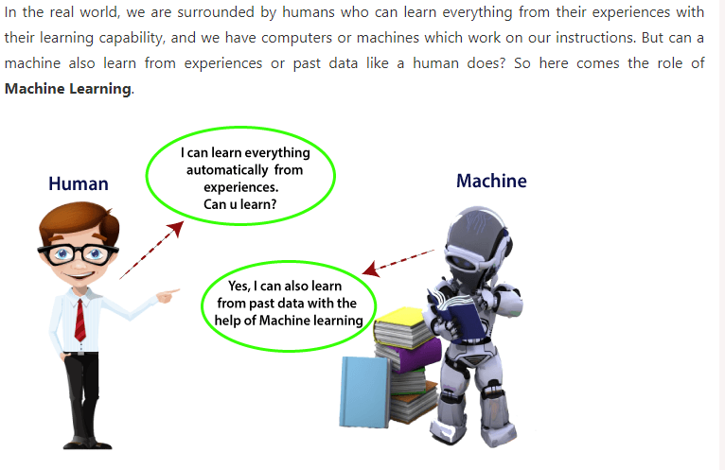
Idea of ML

Slide 7
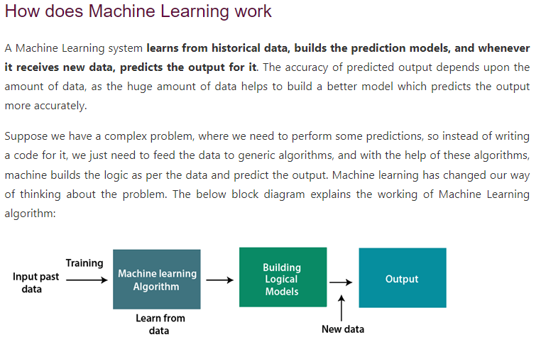
Idea of ML

Slide 8
Definition: ML
The sub field of computer science that “gives computers the ability to learn without being explicitly programmed”
- Artur samuel(1959)
A computer program is said to learn fom experience E with respect to some class of tasks T and performance measure P if ita performance at tasks T, as measured by P, improves with experience E.
-Tom Mitchell(1997)

Slide 9
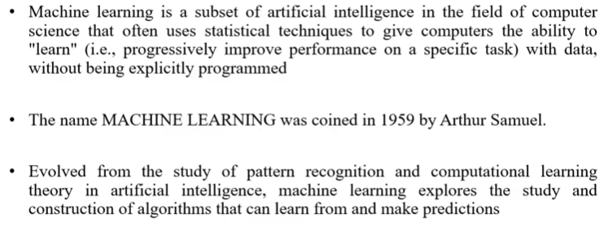
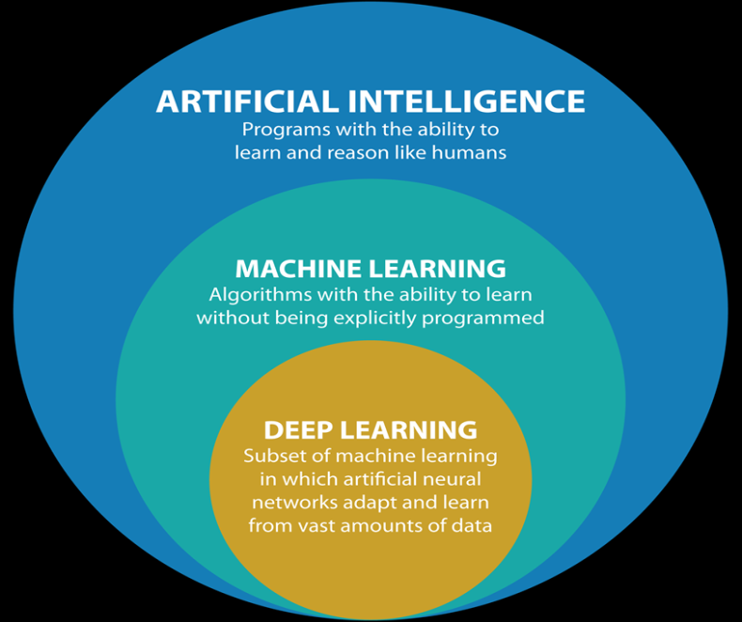
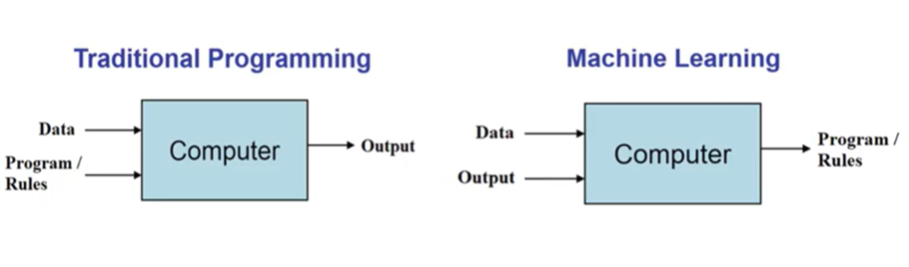
Introduction to ML

Slide 10
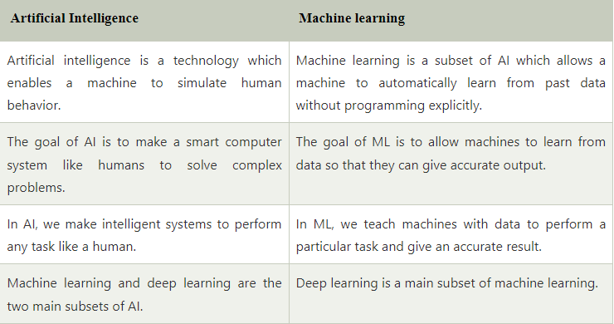
Difference between AI & ML

Slide 11
What is Machine learning?
Machine learning is a field of artificial intelligence (AI).
Machine learning is about making computers modify or adapt their actions so that these actions get more accurate, where accuracy is measured by how well the chosen actions reflect the correct ones.
In simple terms, machine learning means making the machines learn from their experiences like humans and other animals.
The important parts of animal learning are remembering, adapting, and generalizing.
There are plenty of other bits to intelligence, such as reasoning and logical deduction.
Machine learning deals with learning and adopting, whereas AI makes computers reason and deduce facts.
Notes:
Machine learning is the science of getting computers to act without being explicitly programmed.
Machine learning is the concept that a computer program can learn and adapt to new data without human intervention.
Machine learning is a method of data analysis that automates analytical model building.
Machine learning is the use and development of computer systems that are able to learn and adapt without following explicit instructions by using algorithms and statistical models to analyze and draw inferences from patterns in data.
Learning is what gives us flexibility in our lives; we can adjust and adapt to new circumstances and learn new tricks, no matter how old we are.

Slide 12
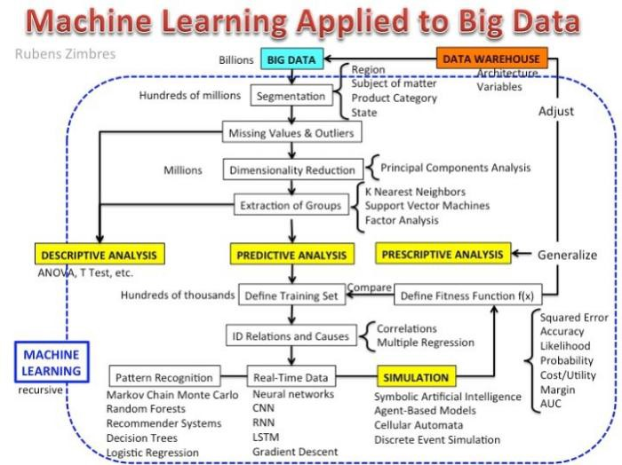

Slide 13
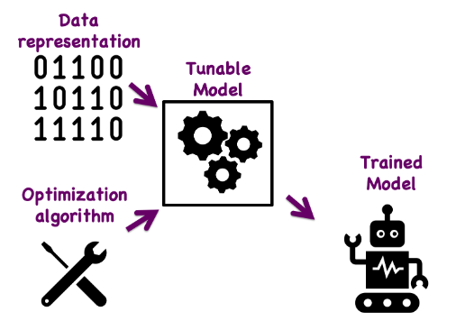
Components and Process of ML
There are seven steps to machine learning, and each step revolves around data.
Data Collection
Data Pre-processing/ Preparation
Feature Selection
Algorithm Choice
Parameter and Model selection
Training
Ealuation

Slide 14
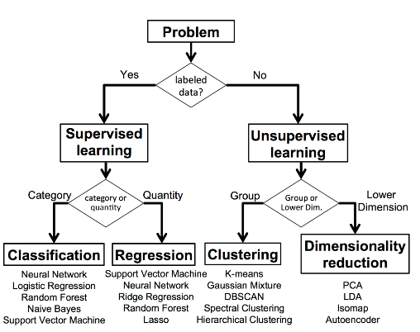
Types of Machine Learning
A machine learning algorithm takes data (With labels or without labels) as input and produces a generalized model that can be used on similar new data.

Slide 15
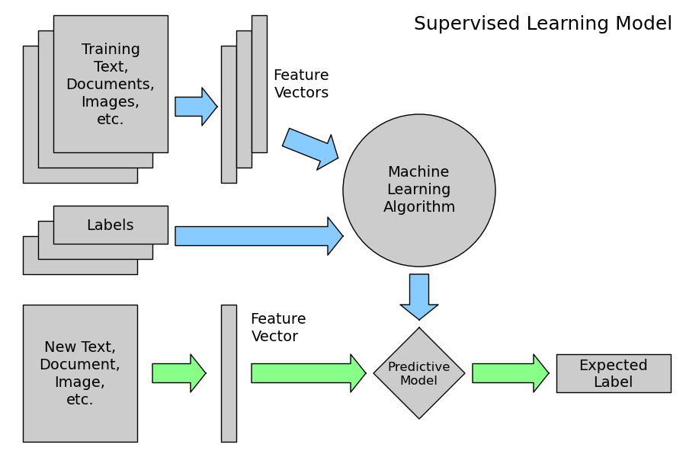
ML: Supervised Learning
Targets/labels will be provided along with features in training set.
Objective: Predicting the labels of a new object when features are given.
This is also called learning from exemplars.

Slide 16
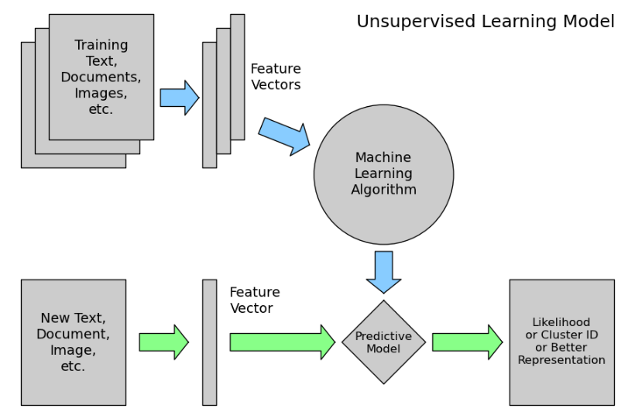
ML: Unsupervised Learning
Targets/labels will not be provided along with features in training set.
Objective: Categorizing the object based on similarities and finding out whether a new object belongs to which category.
The statistical approach to unsupervised learning is known as density estimation.

Slide 17

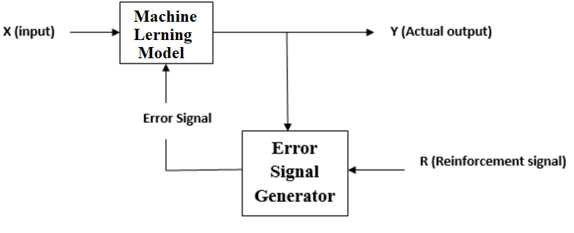
ML: Reinforcement Learning
Somewhere between supervised and unsupervised learning
Objective: Learning from interaction to achieve a goal.
Reinforcement learning is sometimes called learning with a critic because of the monitor that scores the answer but does not suggest improvements.
Notes:
The algorithm gets told when the answer is wrong but does not get told how to correct it. It has to explore and try out different possibilities until it works out "how to get the answer right".
The learner and decision-maker is called the agent. The thing it interacts with, comprising everything outside the agent, is called the environment. These interact continually, the agent selecting actions and the environment responding to those actions and presenting new situations to the agent

Slide 18
ML: Evolutionary Learning
Similar but different then reinforcement learning.
Biological evolution can be seen as a learning process: biological organisms adapt to improve their survival rates and the chance of having offspring in their environment.
Objective: Using an idea of fitness, which corresponds to a score for how good the current solution is? And updating the solution accordingly.
In evolutionary algorithms, they usually start with many "agents" and only the "strong ones survive“.
Notes:
The algorithm gets told when the answer is wrong but does not get told how to correct it. It has to explore and try out different possibilities until it works out "how to get the answer right".
The learner and decision-maker is called the agent. The thing it interacts with, comprising everything outside the agent, is called the environment. These interact continually, the agent selecting actions and the environment responding to those actions and presenting new situations to the agent

Slide 19
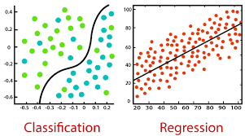
Supervised learning
As discussed earlier, supervised learning is the machine learning task of learning a function that maps an input to an output based on example input-output pairs.
It infers a function from labeled traininAg data consisting of a set of training examples.
There are two types of Supervised Learning techniques:
Regression: Fits the data.
Classification: Separates the data.

Slide 20
Supervised Learning: Regression
Regression models are used to predict a continuous value. Predicting prices of a house given the features of house like size, price etc is one of the common examples of Regression. It is a supervised technique
It predicts continuous/real values such as temperature, age, salary, price, etc.

Slide 21
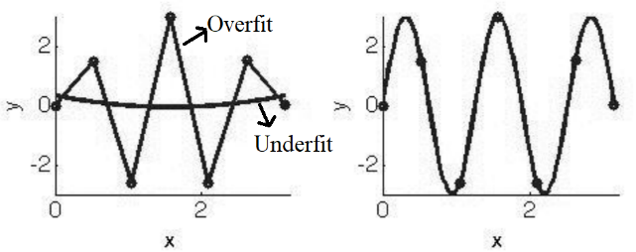
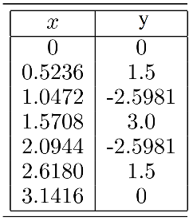
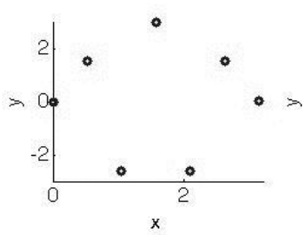
Supervised Learning: Regression
Fits a mathematical function describing a multi dimensional curve/plane so that the curve/plane passes as close as possible to all the data points.
Suppose that given the following data points (a) and asked to find the output's value, when x = 0.44.
The distribution of the data points on a 2D-XY plane is shown in (b).
Regression seems easy when the data has fewer dimensions, but it will become harder and harder as the number of dimensions increases.
(a)
(b)
(c)
(d)
Notes:
There can be an infinite number of models that can fit the given data points. The problem is how to work out what function to choose. An Overfit model and an underfit model were shown in (c). The straight-line approximation (Overfit) probably isn't what we want since it doesn't tell us much about the data. A cubic function (something that can be written as ax³ + bx² + cx + d = 0) (underfit) is nowhere near the data points. In fact, the data were made with the sine function plotted(d), so that is the correct answer in this case.

Slide 22
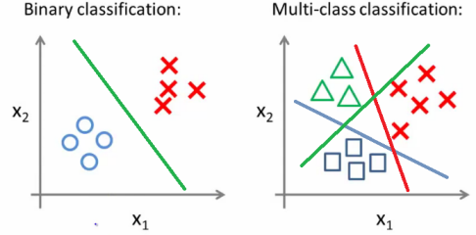
Supervised Learning: Classification
Grouping examples into different classes, i.e., taking input vectors and deciding which of N classes they belong to, based on training from exemplars of each class.
The most important point about the classification problem is that it is discrete.
Many real-world problems use classification.
Notes:
For example, heart disease detection can be identified as a classification problem. This is a binary classification since there can be only two classes, i.e., has heart disease or does not have heart disease. The classifier, in this case, needs training data to understand how the given input variables are related to the class. And once the classifier is trained accurately, it can be used to detect whether heart disease is there or not for a particular patient. Another most common applications of classification are for filtering emails into "spam" or "non-spam," as used by today's top email service providers. An example of multi-class classification is the classification of fruits or classification of animals, etc. Classification algorithms can be better understood using the below diagram.

Slide 23
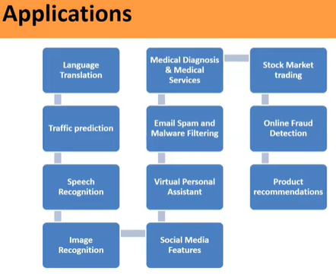

Slide 24
Classification of ML Problems
Problem types | Details | Algorithms
Regression | When the need is to predict numerical values, such kinds of problems are called regression problems. For example, house price prediction | Linear regression, K-NN, random forest, neural networks
Classification | When there is a need to classify the data in different classes, it is called a classification problem. If there are two classes, it is called a binary classification problem. When it is multiple classes, it is multi-nomial classification. For example, classify whether a person is suffering from a disease or otherwise. Classify whether a stock is “buy”, “sell”, or “hold”. Check this related post – Machine learning techniques for stock prediction | Logistic regression, random forest, K-NN, gradient boosting classifier, neural networks
Clustering | When there is a need to categorize the data points in similar groupings or clusters, this is called a clustering problem. | K-Means, DBSCAN, Hierarchical clustering, Gaussian mixture models, BIRCH
Time-series forecasting | When there is a need to predict a number based on the time-series data, it is called a time-series forecasting problem. A time series is a sequence of numerical data points in successive order. Time series data means that data is in a series of particular time periods or intervals. For example, a time-series forecasting problem is about forecasting the sales demand for a product, based on a set of input data such as previous sales figures, consumer sentiment, and weather. Another kind of time series problem is demand forecasting. | ARIMA, SARIMA, LSTM, Exponential smoothing, Prophet, GARCH, TBATS, Dynamic linear models

Slide 25
Anomaly detection | When there is a need to find the outliers in the dataset, the problem is called an anomaly detection problem. In other words, if a given record can be classified as an outlier or unexpected event/item, this can be called an anomaly detection problem. For example, credit card fraud transactions detection is an anomaly detection problem. | IsolationForest, Minimum covariance determinant, Local outlier factor, One-class SVM
Ranking | When there is a need to order the results of a request or a query based on some criteria, the problem is ranking problems. We rank the output of query execution based on scores we assign to each output based on some algorithms. These algorithms are called a ranking algorithm. Recommendation engines make use of the ranking algorithm to recommend the next items. | Bipartite ranking (Bipartite Rankboost, Bipartite RankSVM)
Recommendation | When there is a need to recommend such as “next item” to buy or “next video” to watch or “next song” to listen to, the problem is called a recommendation problem. The solutions to such problems are called recommender systems. | Content-based and collaborative filtering machine learning methods
Data generation | When there is a need to generate data such as images, videos, articles, posts, etc, the problem is called a data generation problem. | Generative adversarial network (GAN), Hidden Markov models
Optimization | When there is a need to generate a set of outputs that optimize outcomes related to some objective (objective function), the problem is called an objective function. | Linear programming methods, genetic programming

Slide 26
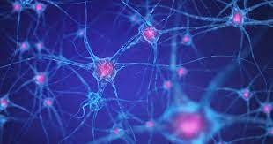
Artificial Neural Network (ANN)
An artificial neural network (ANN) is the piece of a computing system designed to simulate the way the human brain analyzes and processes information.
While the brain is an impressively powerful and complicated system, the basic building blocks that it is made up of are fairly simple and easy to understand.
The animal mainly a human brain has hundreds of billions of cells called neurons.

Slide 27
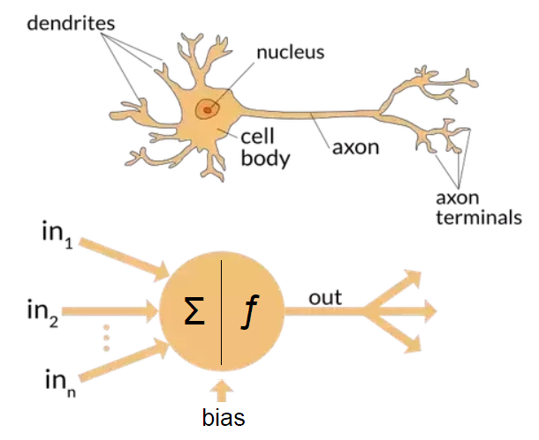
Artificial Neural Network (ANN)
Each neuron comprises
a cell body responsible for processing information.
Dendrites take input from the other neurons.
Axon terminals gives processed output to other neurons.

Slide 28
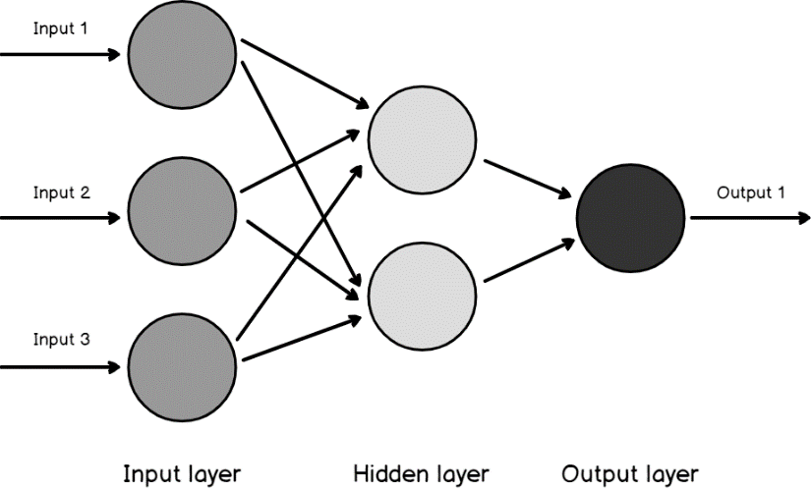
Artificial Neural Network (ANN)
An ANN has hundreds or thousands of artificial neurons called processing units, which are interconnected by nodes.
These processing units are made up of input and output units.
The input units receive various forms and structures of information based on an internal weighting system.
The neural network attempts to learn about the information presented to produce one output report.
Just like humans need rules and guidelines to come up with a result or output, ANNs also use a set of learning rules called backpropagation, an abbreviation for backward propagation of error, to perfect their output results.

Slide 29
ML: Terminology
Inputs: An input vector is the data given as one input to the algorithm and written as x, with elements x_{i}, where i runs from 1 to the number of input dimensions, m.
Weights: w_{ij}, are the weighted connections between nodes i and j. For neural networks, these weights are analogous to the synapses in the brain. They are arranged into a matrix W.
Outputs: The output vector is y, with elements y_{j}, where j runs from 1 to the number of output dimensions, n. We can write y(x, W) to remind ourselves that the output depends on the inputs to the algorithm and the network's current set of weights.

Slide 30
ML: Terminology
Targets: The target vector t, with elements t_{j}, where j runs from 1 to the number of output dimensions, n, are the extra data that we need for supervised learning since they provide the 'correct' answers that the algorithm is learning about.
Activation Function: For neural networks, g(·) is a mathematical function that describes the firing of the neuron as a response to the weighted inputs.
Error (E): a function that computes the inaccuracies of the network as a function of the outputs y and targets t.

Slide 31
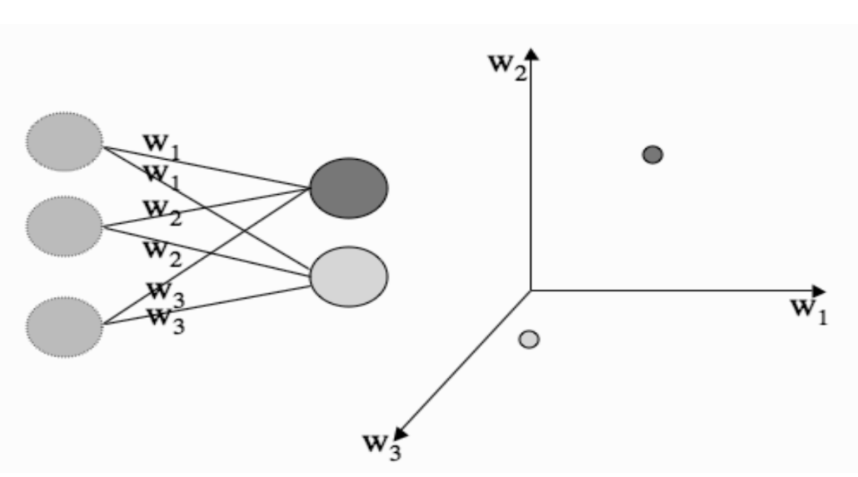
Weight Space
When working with data, it is often useful to plot it and look at it.
As well as plotting data points, we can also plot anything else that we feel like.
This is useful for neural networks since a neural network's parameters are the values of a set of weights that connect the neurons to the inputs.
Notes:
A neural network schematic on the left of the figure below shows the left and the neurons' inputs on the right. If we treat the weights fed into one of the neurons as a set of coordinates in what is known as weight space, we can plot them. We think about the weights that connect into a particular neuron, and plot the strengths of the weights by using one axis for each weight that comes into the neuron, and plotting the position of the neuron as the location, using the value of w1 as the position on the 1st axis, the value of w2 on the 2nd axis, etc. This is shown on the right of the figure. So we can use the idea of neurons and inputs being 'close together in order to decide when a neuron should fire and when it shouldn't. If the neuron is close to the input in this space, it should fire, and if it is not close, it shouldn't.

Slide 32
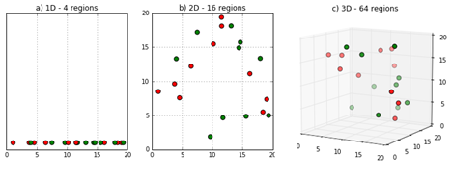
The Curse of Dimensionality
The curse of dimensionality will apply to our machine learning algorithms.
Unnecessary and redundant features increases the complexity of model and may even reduce the performance of model if enough training data is not there.
As the number of input dimensions gets larger, we will need more data to enable the algorithm to generalize sufficiently well.
Our algorithms try to separate data into classes based on the features; therefore, as the number of features increases, the number of data points we need increases.

Slide 33

Testing Machine Learning Algorithms
How to know whether the trained ML model will perform well?
Data set used for training the model can’t be used testing the model as the data was already seen by the model.
Solution: Divide the dataset into training and testing datasets.
The ML model will be trained using training set and then the model will be tested using the unseen testing dataset to check how well it is performing.

Slide 34
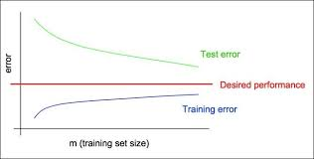
Train/Test error comparison: Learning Curves
Observe test error is more
When compare to train error of
the linear model
Here the model is doing well for training data but
Failing for test data.

Slide 35
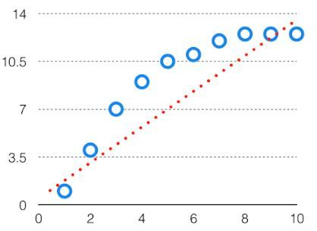
Bias
The bias is known as the difference between the prediction of the values by the ML model and the actual training value.
High in biasing gives a large error in training as well as testing data. Its recommended that an algorithm should always be low biased to avoid the problem of underfitting. By high bias, the data predicted is in a straight line format, thus not fitting accurately in the data in the data set. Such fitting is known as Underfitting of Data.
This happens when the hypothesis is too simple or linear in nature. Refer to the graph given below for an example of such a situation.

Slide 36
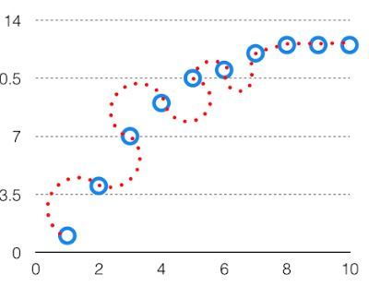
Variance
If the machine learning model performs well with the training dataset, but does not perform well with the test dataset, then variance occurs.
The model with high variance has a very complex fit to the training data and thus is not able to fit accurately on the test data. As a result, such models perform very well on training data but has high error rates on test data.
When a model is high on variance, it is then said to as Overfitting of Data. Overfitting is fitting the training set accurately via complex curve and high order hypothesis but is not the solution as the error with unseen data is high. While training a data model variance should be kept low.
The high variance data looks like follows.

Slide 37
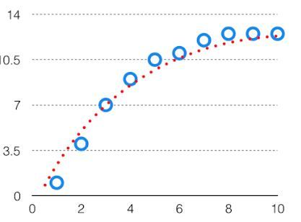
Bias Variance Tradeoff
If the algorithm is too simple (hypothesis with linear eq.) then it may be on high bias and low variance condition and thus is error-prone.
If algorithms fit too complex ( hypothesis with high degree eq.) then it may be on high variance and low bias. In the latter condition, the new entries will not perform well. Well, there is something between both of these conditions, known as Trade-off or Bias Variance Trade-off.
This tradeoff in complexity is why there is a tradeoff between bias and variance. An algorithm can’t be more complex and less complex at the same time. For the graph, the perfect tradeoff will be like. The best fit will be given by hypothesis on the tradeoff point.

Slide 38
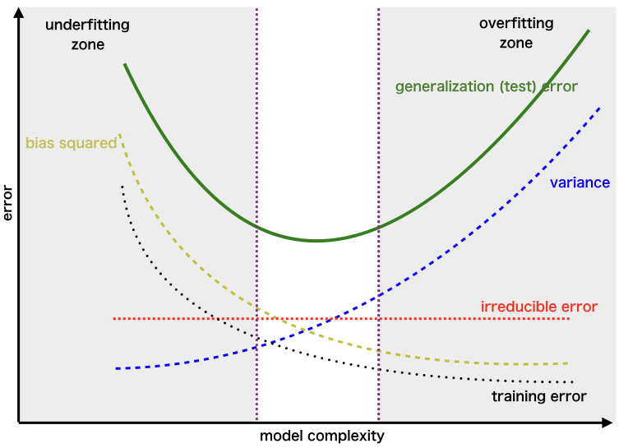
The error to complexity graph to show trade-off
Examples of low-bias machine learning algorithms include: Decision Trees, k-Nearest Neighbors and Support Vector Machines.
Examples of high-bias machine learning algorithms include: Linear Regression, Linear Discriminant Analysis and Logistic Regression.

Slide 39
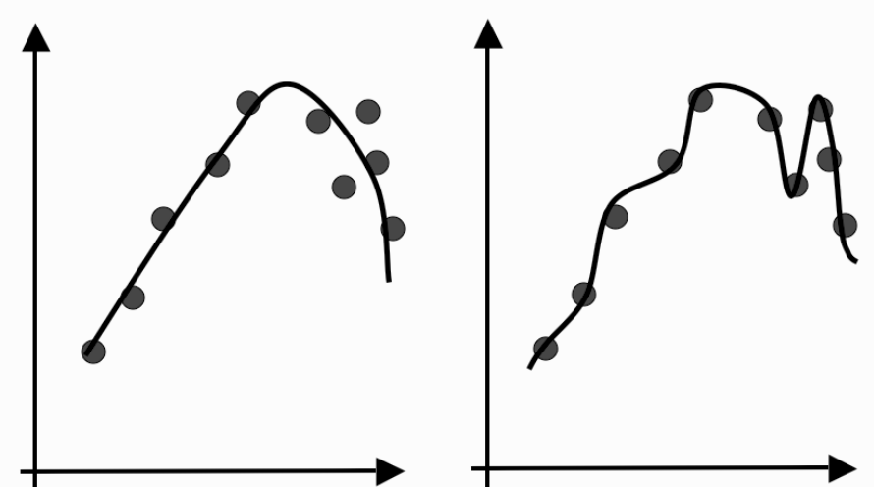
ML: Overfitting
How well the algorithm is generalizing as it learns?
There is at least as much danger in over-training as there is in under-training.
If we train for too short, we may underfit the data on the other hand if we train for too long, we may overfit the data.
Overfitting means instead of constructing a generalized model, the model learns about the noise and inaccuracies in the data.

Slide 40
ML: Overfitting
An overfitted model will surely give a small error during traininging but will give large errors during testing.
We want to stop the learning process before the algorithm overfits, which means that we need to know how well it generalizes at each timestep.
We can't use the training data because we wouldn't detect overfitting, but we can't use the testing data either because we're saving that for the final tests.
Solution: We need a third set of data to use for this purpose, which is called the validation set because we're using it to validate the learning so far.
Also known as cross-validation in statistics.

Slide 41
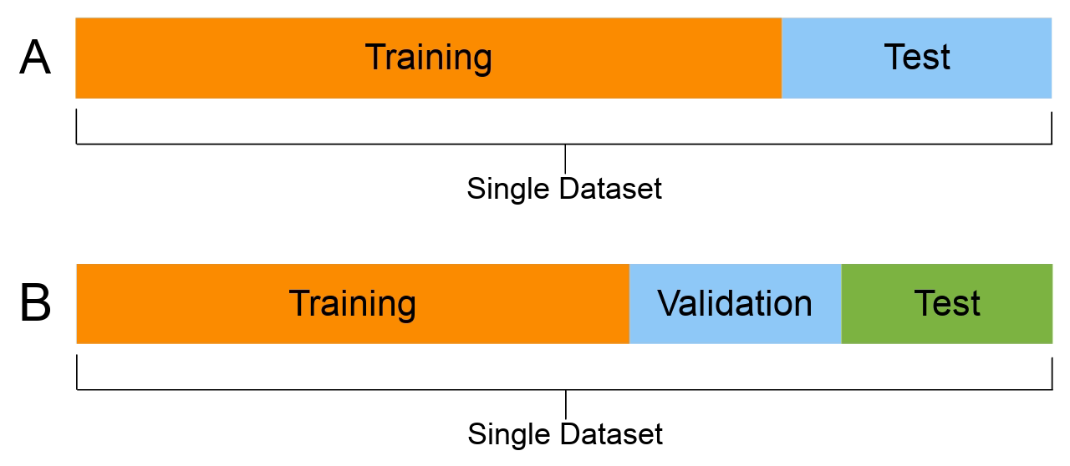
ML: Overfitting
We now need three sets of data: the training set to actually train the algorithm, the validation set to keep track of how well it is doing as it learns, and the test set to produce the final results.
The general proportions used for splitting the data sets are 50:25:25 or 60:20:20.
It is also recommended to randomize the dataset before splitting.

Slide 42
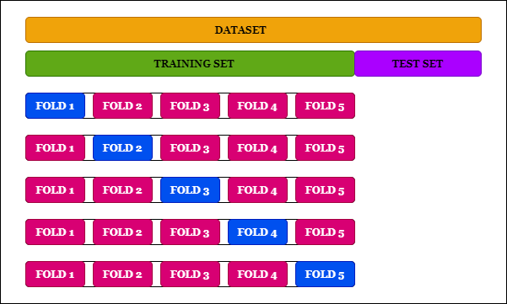
ML: Overfitting
If you are really short of training data so that if you have a separate validation set, there is a worry that the algorithm won't be sufficiently trained.
Solution is possible to perform leave-some-out, multi-fold cross-validation.
The dataset is randomly partitioned into K subsets, and one subset is used as a validation set, while the algorithm is trained on all of the others.

Slide 43
ML: Underfitting
Underfitting refers to a model that can neither model the training data nor generalize to new data.
An underfit machine learning model is not a suitable model and will be obvious as it will have poor performance on the training data.
Underfitting is often not discussed as it is easy to detect given a good performance metric. The remedy is to move on and try alternate machine learning algorithms. Nevertheless, it does provide a good contrast to the problem of overfitting.
Note: Ideally, you want to select a model at the sweet spot between underfitting and overfitting.This is the goal, but is very difficult to do in practice.

Slide 44
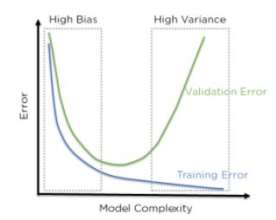
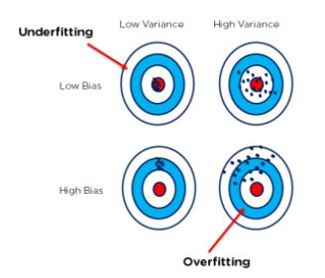
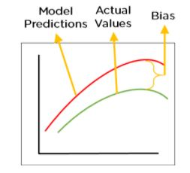
Bias, Variance and Tradeoff
Bias | Variance | Tradeoff
Error between predicted values by ML model with training data( Actual value). | Error between predicted values by ML model with testing data( Actual value). | For any model, we have to find the perfect balance between Bias and Variance. This just ensures that we capture the essential patterns in our model while ignoring the noise present it in. This is called Bias-Variance Tradeoff
The overfitted model has low bias and high variance. Cross-Validation, Training with more data, Removing features Early stopping the training, Regularization, Ensembling | An underfitted model has high bias and low variance. By increasing the training time of the model. By increasing the number of features. | Low bias , low variance

Slide 45
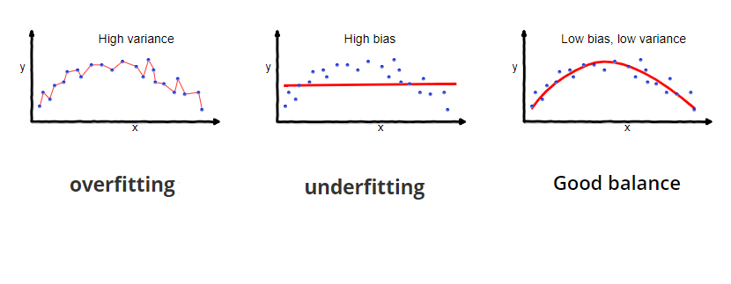
Overfitting, Underfitting and Best fitting:
Over fitting | Underfitting | Best fitting
Overfitting occurs when our machine learning model tries to cover all the data points or more than the required data points present in the given dataset. | Underfitting occurs when our machine learning model is not able to capture the underlying trend of the data. | it defines how closely the result or predicted values match the true values of the dataset.
the model starts caching noise and inaccurate values present in the dataset, and all these factors reduce the efficiency and accuracy of the model. | In the case of underfitting, the model is not able to learn enough from the training data, and hence it reduces the accuracy and produces unreliable predictions.
The overfitted model has low bias and high variance. Cross-Validation, Training with more data, Removing features Early stopping the training, Regularization, Ensembling | An underfitted model has high bias and low variance. By increasing the training time of the model. By increasing the number of features. | Low bias , low variance

